Slide 1


AI Migration Assistant
V1.
Guadalupe Solis
Notes:
Good day, everyone! My name is Guadalupe Solis, and today, I’m excited to introduce you to a project that’s been close to my heart—AI Migration Assistant. As someone who migrated to Portugal myself, I realized firsthand how daunting it can be to navigate the sea of scattered information when trying to move to a new country. My experience inspired me to create a solution that could help simplify the migration process for others facing the same challenges.

Slide 2
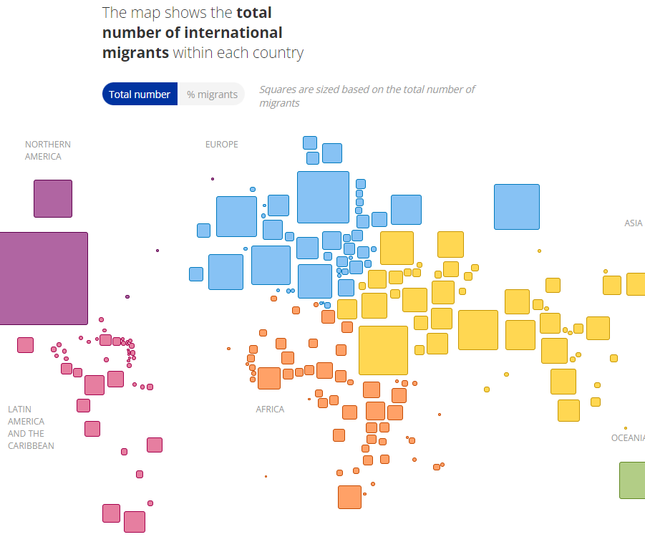

The Challenge of Migration
Migrating to a new country can be overwhelming. Information is scattered across multiple websites, processes are often unclear, and it’s difficult to know where to start
According to UN’s World Migration Report, over 280 million people are international migrants, many of whom face significant challenges during the relocation process.
Notes:
Let’s start with the challenge. Migration is a complex process, and whether you’re moving for work, family, or a fresh start, it often feels overwhelming. Imagine juggling between multiple government portals, housing websites, embassies, and more—just to get your documents in order. In fact, according to the UN’s World Migration Report, over 280 million people are international migrants, and many of them face similar struggles in their journeys. So, I asked myself: How can I make this easier?

Slide 3
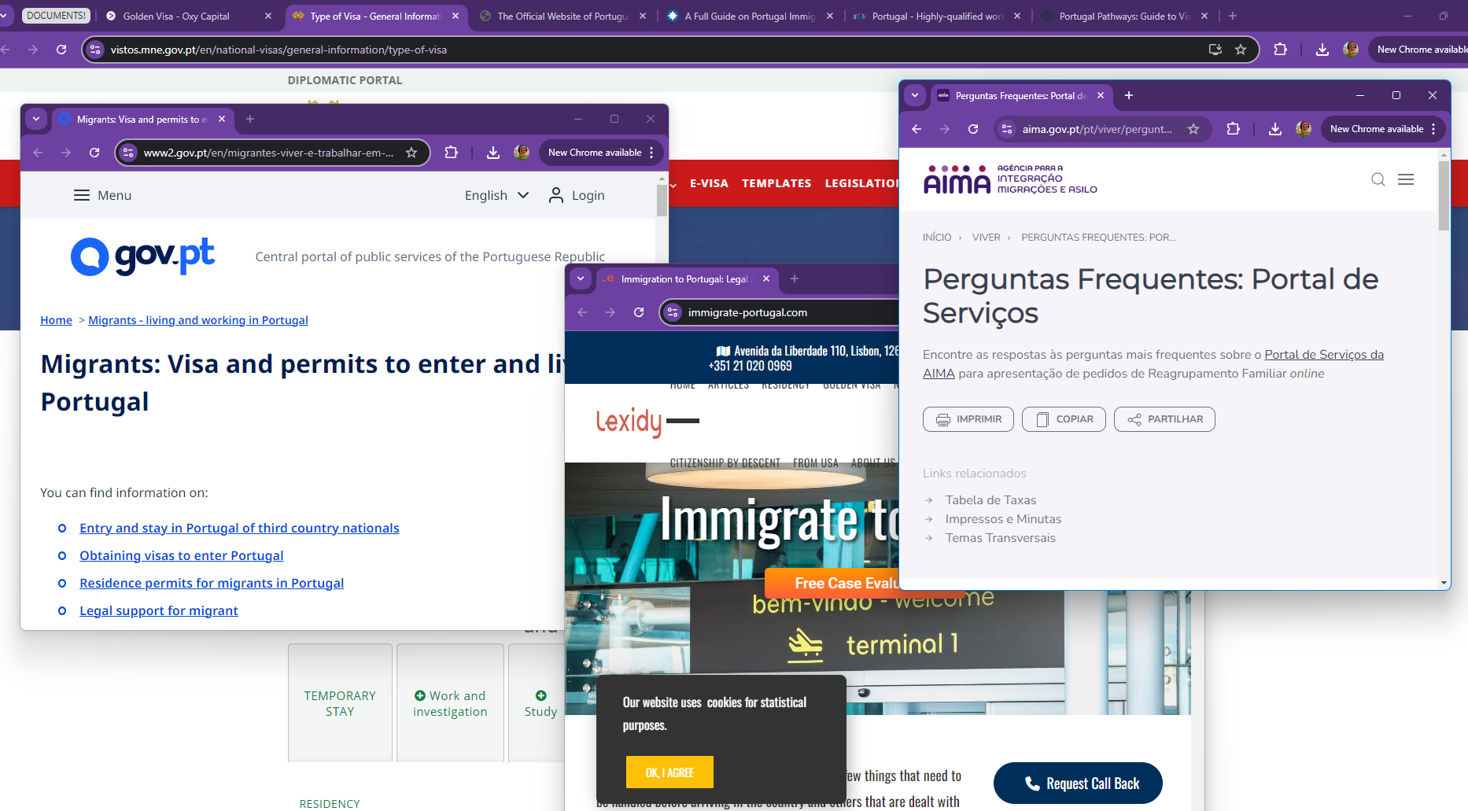
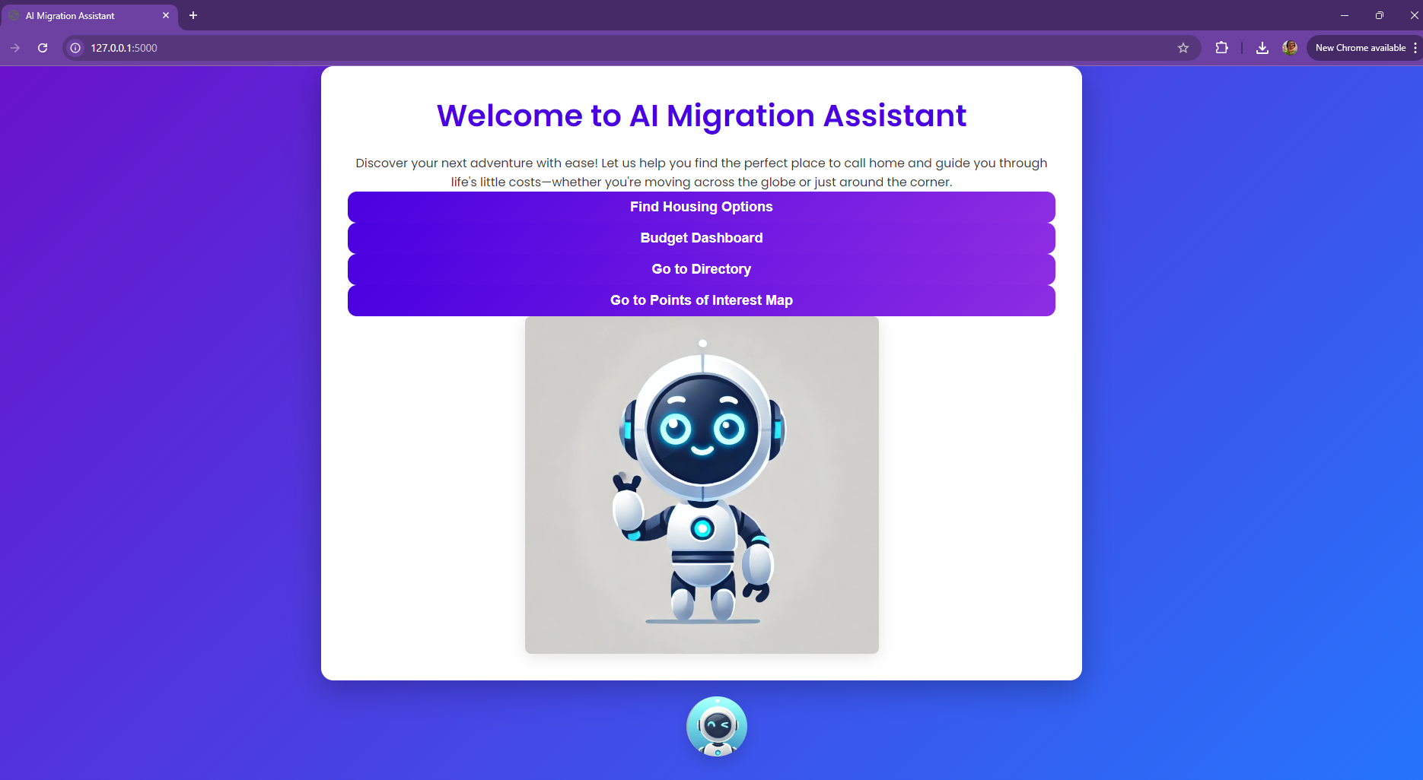
The Origin Story
After repeatedly helping friends and acquaintances with their migration questions, I realized the need for a centralized tool that could simplify the process for everyone.
Key Insight: "What if there was one place where you could find housing, visa information, embassies, and public offices all in one app?"
Notes:
That’s how the idea for AI Migration Assistant came to be. After helping many friends and acquaintances with their migration questions, it became clear that we needed a one-stop solution that could centralize everything. Imagine if there was just one tool to find housing, visa information, embassy details, and more. This was the driving idea behind my project.

Slide 4

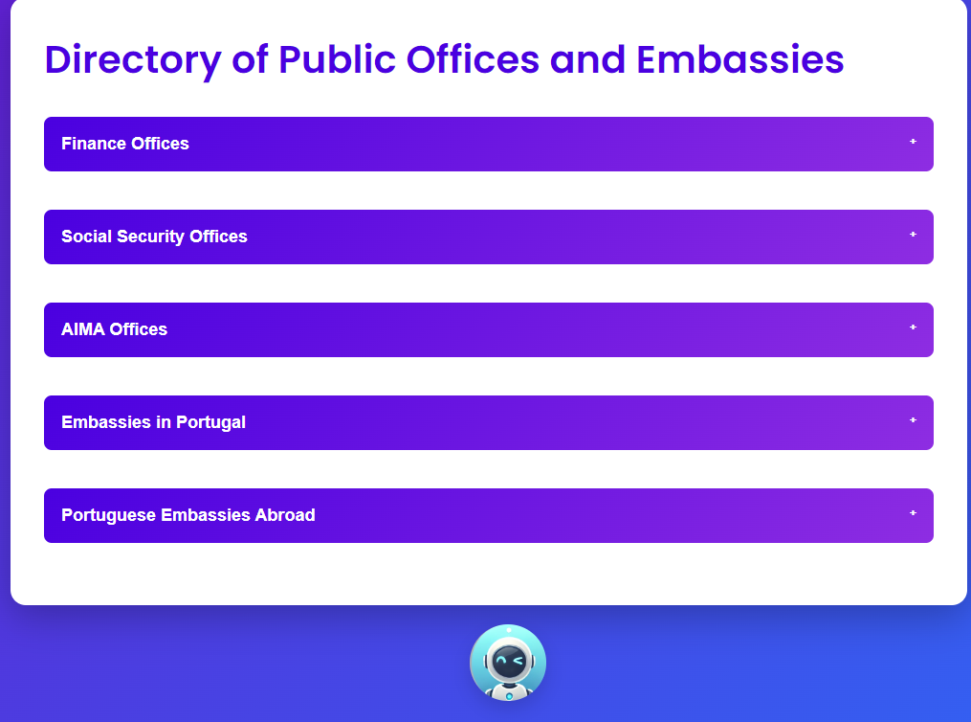
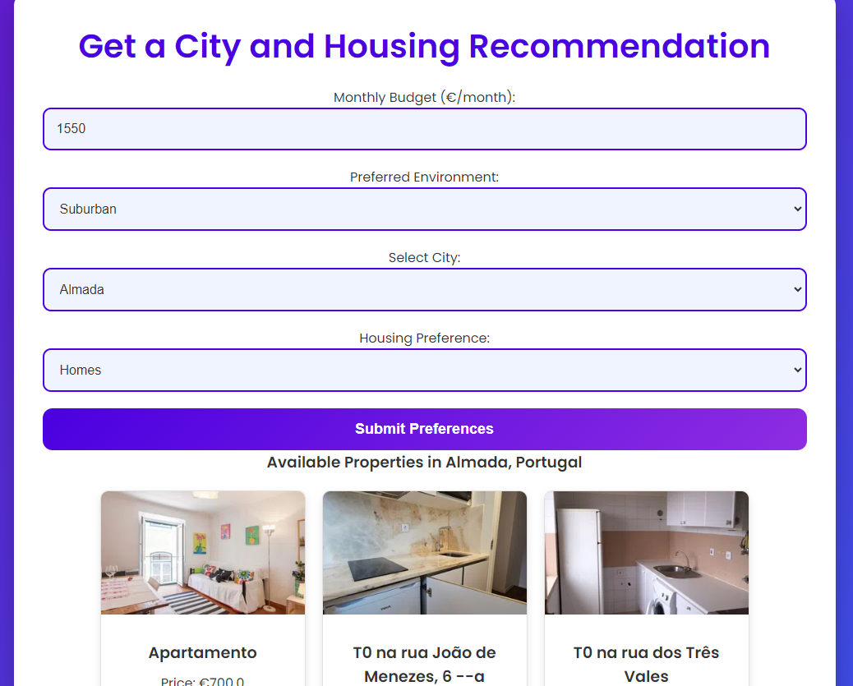
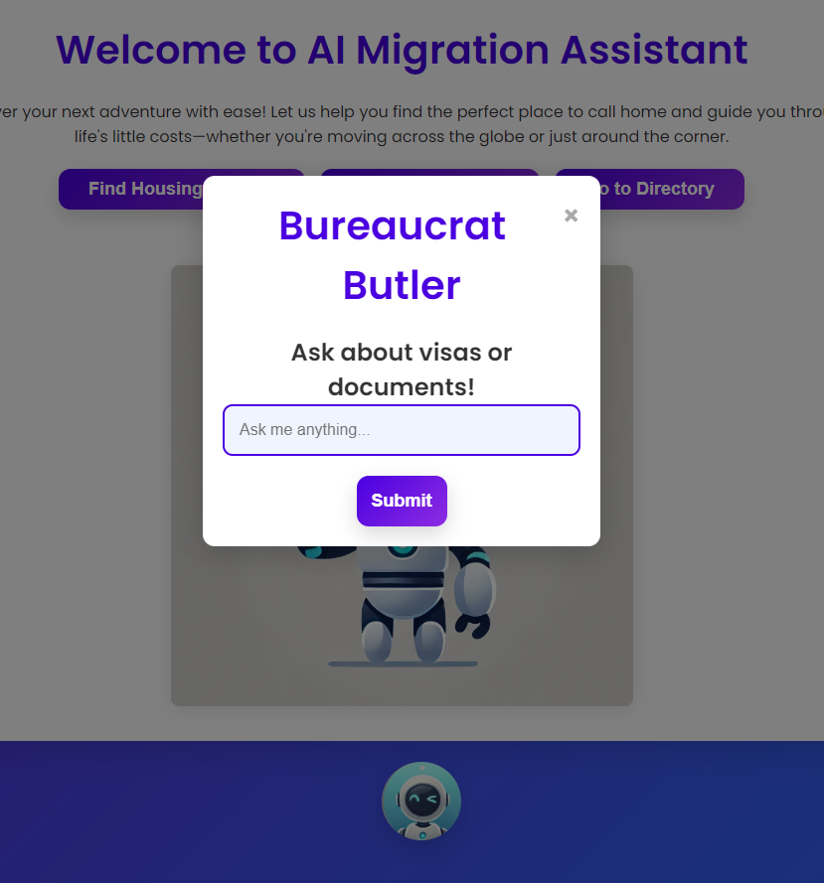
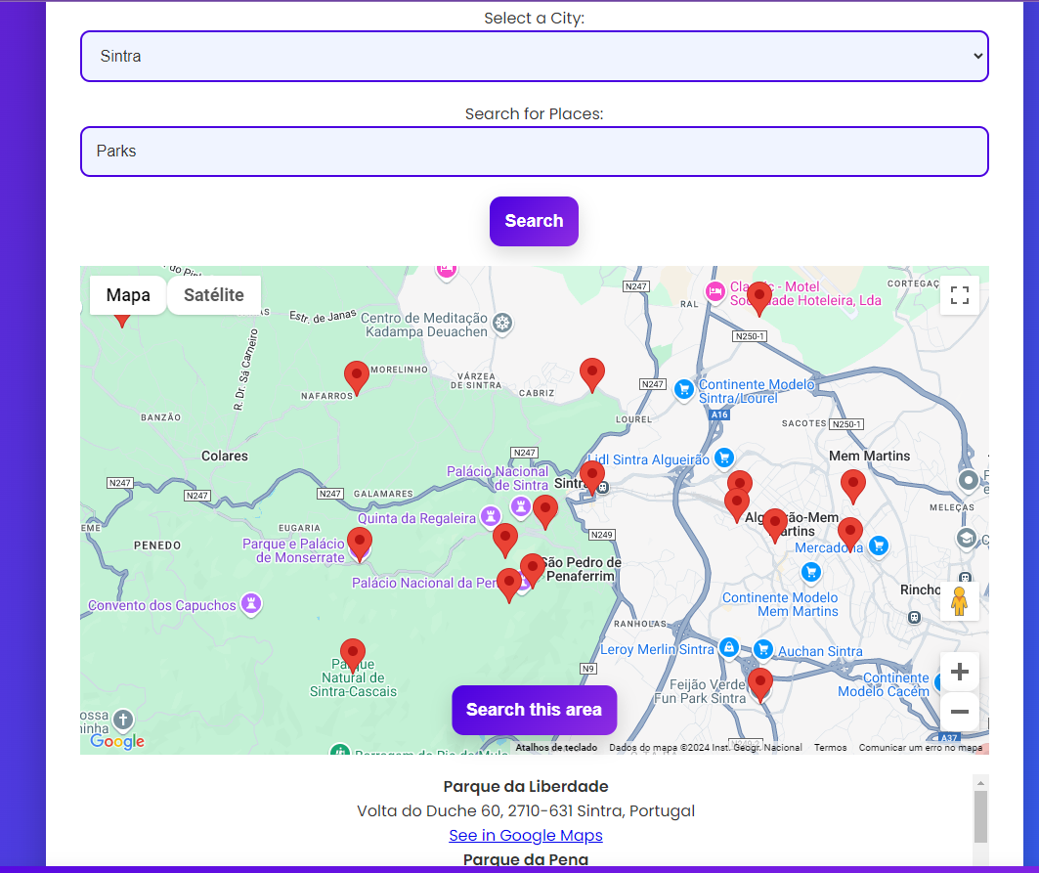
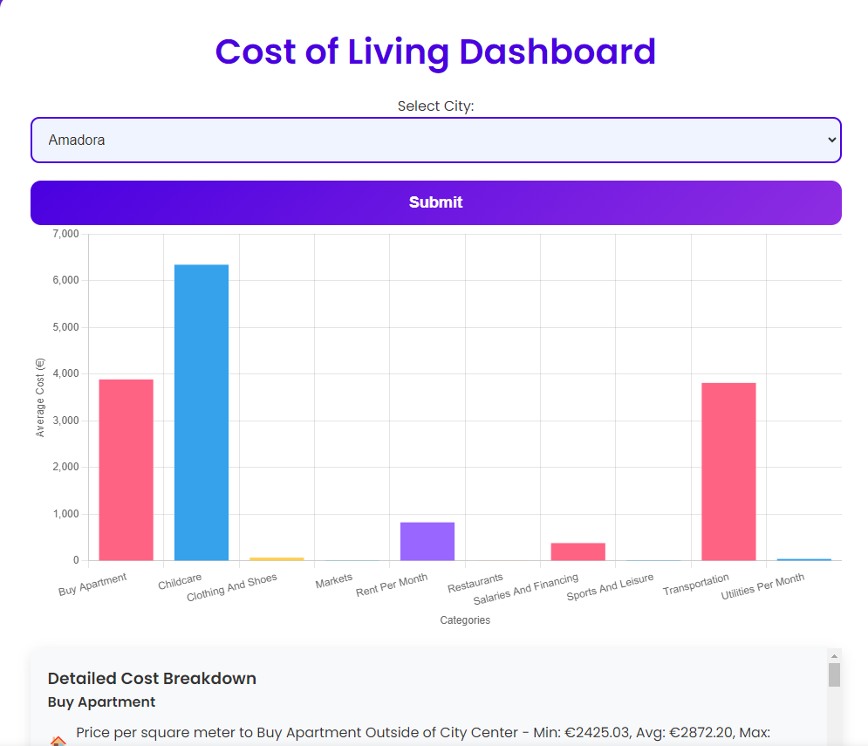
Introducing the AI Migration Assistant
The AI Migration Assistant is designed to simplify the migration process by providing centralized access to housing options, visa information, public office directories, and even points of interest—all in one platform.
Key Features:
Housing recommendations tailored to budget and preferences.
Visa and document assistant powered by a chatbot.
Public office and embassy directory.
Interactive map of points of interest.
Notes:
And so, I created the AI Migration Assistant. This app is designed to make migration less intimidating by bringing everything you need into one platform. It provides tailored housing recommendations based on your budget, a chatbot that helps with visa and document information, a directory of public offices and embassies, and even an interactive map with points of interest. Essentially, it's your virtual migration assistant, helping you every step of the way.

Slide 5
Let’s see it working!
Click on the bot!
Notes:
Let’s take a quick peek into how the AI Migration Assistant works in action. [At this point, you can interact with the bot or demonstrate one of the key features in the app.] Whether you’re looking for housing or need to know which embassy handles your visa, it’s all right there at your fingertips.

Slide 6
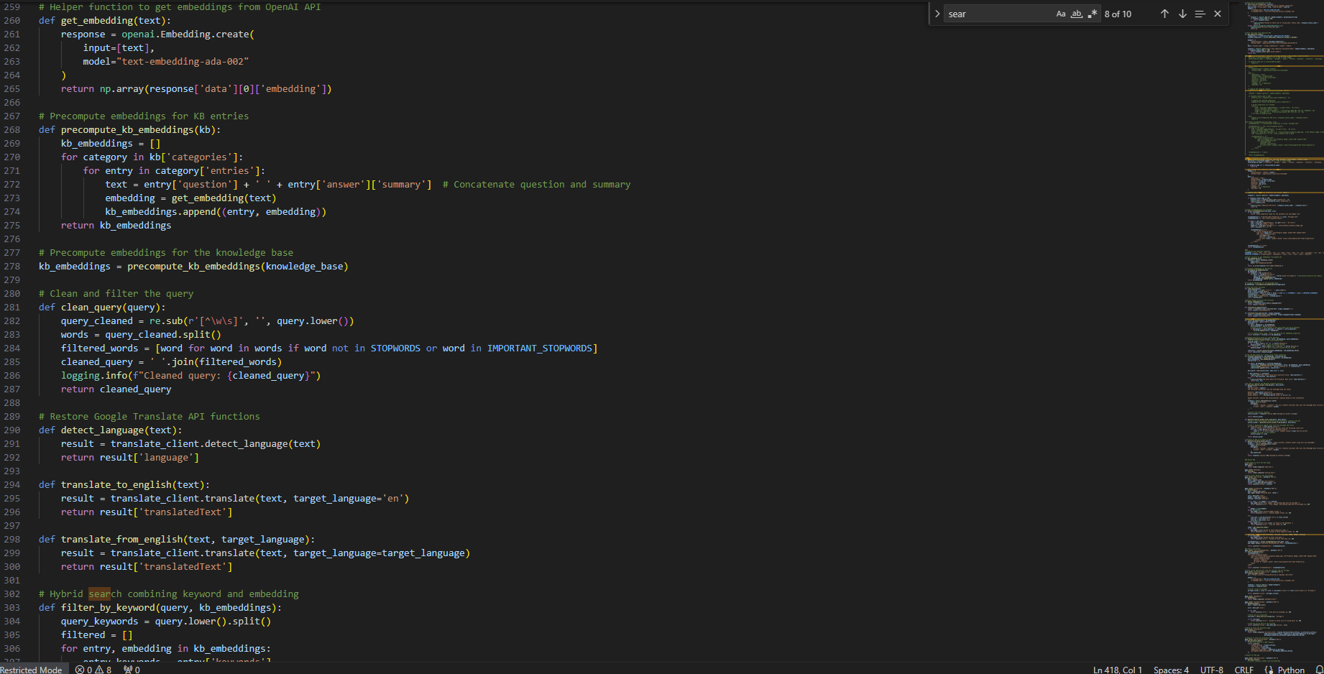



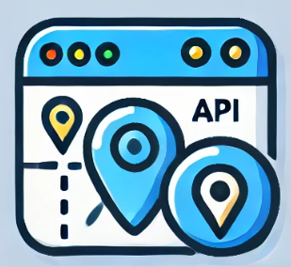
Building the Assistant
Building the AI Migration Assistant has been an iterative and challenging journey. It all started with the chatbot, the heart of the assistant, which proved to be the most difficult part of the development process. I spent three weeks trying to achieve satisfying results. Initially, the bot was designed to rely on simple keyword searches, which yielded mixed results.
As I progressed, I experimented with different techniques—first attempting to incorporate BERT embeddings, and then turning to GPT to generate more natural responses. After much trial and error, I found the right balance by combining OpenAI’s embeddings with GPT’s capabilities to give the bot a natural, conversational tone while ensuring it was trained on my knowledge base.
After successfully developing the bot, I used the last week of the project to build the other features. I integrated the Idealista API for housing listings, implemented Google Maps for location data, and designed the Points of Interest map. The final product was the culmination of weeks of intensive problem-solving, integration, and refinement.
Notes:
Now, let me take you behind the scenes. Building the AI Migration Assistant was no small task. The heart of this app is the chatbot, which took a solid three weeks of development and testing. Initially, it only worked with simple keyword searches, and the results were pretty inconsistent. But as I dove deeper, I experimented with BERT embeddings, and eventually, I incorporated GPT to make the bot more conversational and intuitive. It wasn’t until I integrated OpenAI’s embeddings that I finally got the natural, well-trained bot I was aiming for."
"Once the bot was solid, I only had a week left to build out the other features, like the Idealista API for housing listings and Google Maps for location data. It was a whirlwind of coding, designing, and troubleshooting, but in the end, I brought the entire ecosystem together."

Slide 7






Challenges and Future Vision
One of the main challenges during development was creating a knowledge base for the chatbot that remains up-to-date. I currently manage this manually, but in the future, I aim to automate these updates, pulling from official sources across the web to keep the bot's information fresh and accurate.
In the future, I plan to expand the app to cover more countries beyond Portugal. By integrating APIs such as Numbeo, I can offer better cost-of-living insights and improved recommendations tailored to each user's needs. Additionally, I'd like to introduce a job directory to help migrants find employment in their new country, turning the AI Migration Assistant into an even more comprehensive tool.
Main Challenges
The Future
Updating the Knowledge base
Expanding to more countries
Data consistency
Creating a job directory
Manual Information Management
Integrating better APIs to improve data quality
Notes:
Of course, there were challenges. One of the biggest ones is managing the knowledge base for the bot. Currently, I update the visa and document information manually, which can be time-consuming. I’m hoping to automate this in the future by pulling real-time data from trusted sources."
"Looking forward, my vision is to expand this app beyond Portugal to other countries. I also plan to integrate more powerful APIs, like Numbeo for cost-of-living data, to offer users smarter, more personalized recommendations. Additionally, I want to introduce a job directory to help migrants find employment opportunities in their new country.

Slide 8

Empowering migration with reliable, centralized information.
Notes:
Ultimately, I see this app growing into a global resource for migrants everywhere."

Slide 9
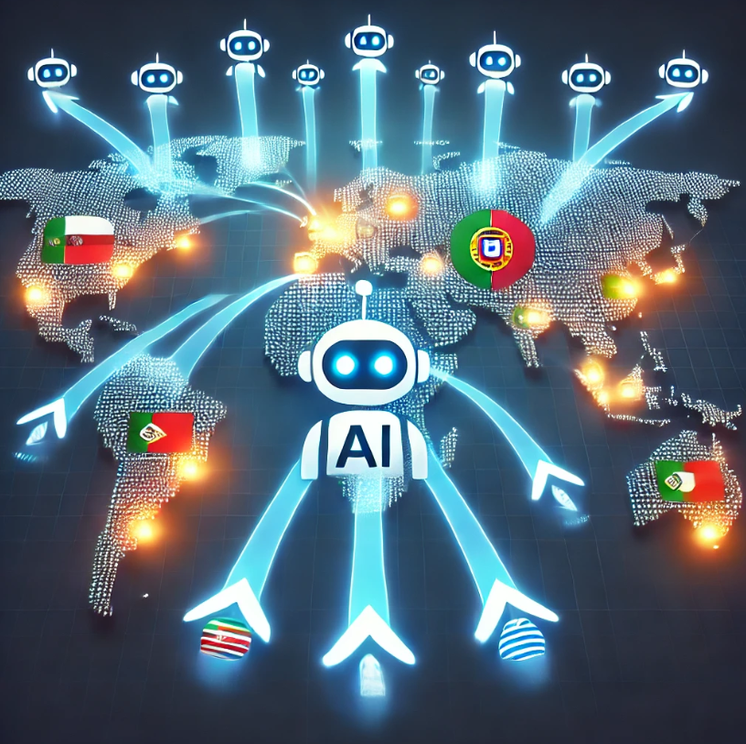
Bringing it all together
The AI Migration Assistant is more than just a tool—it's a solution designed to empower people as they embark on their migration journeys. Whether it’s finding housing, understanding visa requirements, or accessing Points of Interest, the app brings all essential information into one place, making migration simpler and more manageable.
Our future vision is to grow beyond Portugal and expand this tool to assist migrants worldwide. The ultimate goal is to simplify migration for millions, ensuring that people have the confidence and support they need every step of the way.
Notes:
In closing, AI Migration Assistant is more than just an app—it’s a comprehensive solution designed to empower people during one of the most significant transitions of their lives. Migration should be exciting, not overwhelming. With this tool, people can move forward with confidence, knowing they have access to the information and support they need—all in one place.

Slide 10

Join us in making migration simpler for everyone
With your feedback and support, we can turn the AI Migration Assistant into a global resource for migrants everywhere.
Notes:
Together, with your feedback and support, we can continue to refine and expand the AI Migration Assistant, making migration simpler for everyone, everywhere."
"Thank you!”

